Slide 1
Minimize Environment for CI Test
Felix Yuan
Mar 13 2017

Slide 2
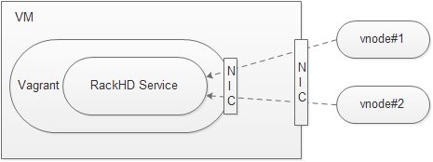
What’s the problem to solve
Situation:
Current CI testing is running RackHD within Vagrant, source code is cloned (with package installation) in host VM and shared with Vagrant. External vNode connects with RackHD via elaborate network setup.
Problems:
Too many virtualization layers thus increase resource consumption and impact RackHD performance
Complex network topology between vNode and RackHD
Some CI issues were introduced by Vagrant.
For PR Gate & Continuous CI: Vagrant up + RackHD Services boots up takes more than 15 min!!!!

Slide 3
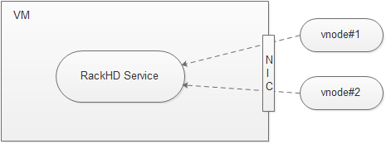
Proposed Solution
Remove Vagrant layer from CI testing (PR Gate & Continuous CI)
Use VM snapshot can quickly backup & restore environment (Ensure all testing running on same environment)
Keep “Image Post Test” (OVA/Docker/Vagrant).

Slide 4
Why not docker or ova?
Source code is the focus for PR gate and Continuous CI, no matter it is get from git or debian. But any make-up for source code is introducing additional complexity.
Either docker or ova introduces environment complex, use minimized/clean/pure/thin environment will minimize the environment problem and speed up testing
Source code level testing is the basic of all other testing, If source code fails on minimized environment, all other testing (docker/ova/vagrant) will certainly fail.

