Slide 1
RackHD CI/CD Introduction
RackHD.CI@emc.com
2017.6

Slide 2
Agenda
Overview
CI/CD Layers
CI/CD Tools
RackHD Delivery
Jenkins Infrastructure
RackHD CI 101
guidelines
How to Install
How to Build
How to Test
Pipelines
Others
Release Process
Jenkins Mirror
CI/CD Roadmaps
CI Development : Process & Co-work
Backup slides
Jenkins Pipeline Matrix
RackHD CI/CD Pulse
Pipeline Tips
More other Tips

Slide 3
Overview

Slide 4
CI/CD layers in RackHD
Test
Build
Release
PR Gates
Travis-CI / Hound / Coverage
Jenkins
Continuous-Regression
Continuous-Smoke-Test
Continuous-Unit-Test
Continuous-OS-Install-Test (on physical nodes)
Nightly Build
Guided by manifest file ( everyday EST 12:00AM)
Smoke-test + image-post-test
Sprint Release
Simulator*
vNode
Phy
Node
Per-Commit-Release ^{(roadmap item)}
epic RAC-4540 , wait CC’s version naming discussion
Dev builds *

Slide 5
Introduction of InfraSIM
infrasim.readthedocs.io
IP:5901
Virtual Computer
bridge
RackHD Management DHCP network
172.31.128.xx
Virtual BMC

Slide 6
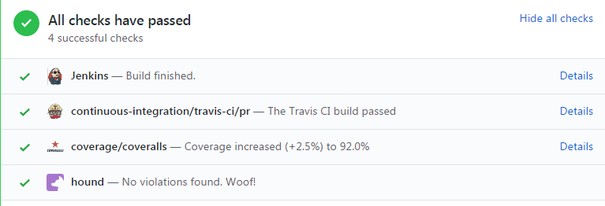
CI/CD Toolchains
Q: Travis-CI is for unit-test, is it duplicated with Jenkins ?
A: No, Jenkins Pipeline will go thru all steps including FIT, so it’s “slower” than Travis. Travis can provide quicker feedback .
Travis-CI
Unit-test, build deb/upload
Hound
Code style violations check
Coverage
Unit-test coverage test
Jenkins
Handle PR dependency
Unit-Test, image build
Test with InfraSIM
Multiple slaves parallel running
More power…

Slide 7
RackHD Delivery
Deb: https://bintray.com/rackhd
Vagrant: https://atlas.hashicorp.com/rackhd/boxes/rackhd
Docker: https://hub.docker.com/u/rackhd/
OVA: http://147.178.202.18/job/SprintRelease/lastSuccessfulBuild/artifact/build/packer/
Npm: https://www.npmjs.com/package/rackhd
As a open source project, Source Code is our first level delivery .
And there will be some pre-build deliveries as below:
Debian package
Vagrant Box
Docker image
VMWare ova
Npm package
More… *
dockerhub
Jenkins artifacts
Official npm registry
Future: in Pypi & npm..etc

Slide 8
Jenkins Infrastructure
Vcenter : https://veyronvc.apps.cia.lss.emc.com
Hosting : ESXI 6.5 and 6.0 ESXI servers at 10.***.19. (230, 233, 160, 173, and 143)
Resources Memory capacity: 895 GB
CPU capacity: 194GHZ
VMslave:
Dedicated to CIT and FIT: vmslaves2, 3 , 21-26
Dedicated to OS install on Vnodes: 10-20
Dedicated to continuous unit test: vmslave04 host 143
Dedicated to regression test: vmslave05 host 143
Jenkins master running on host 143
rackhdci.lss.emc.com/lockable-resources/

Slide 9
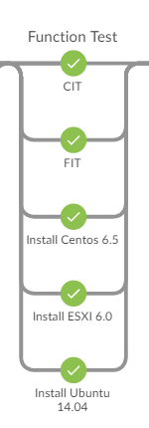
Jenkins Infrastructure (Continued)
vNode
vNode deployment
3 vNode per each test.
deploy vnode ova for each test.
VM Pools
Common slave setup
Share loading to support parallel test/build
Blueprint:
Currently , 1 stack (1 RackHD + 3 vNode) is used for a test. @Andre is designing 1 stack for all (1 RackHD + N vNodes)
Slave configuration under source control
Community be capable to set up and reproduce the Jenkins test environment. [RAC-4657]

Slide 10
CI/CD 101

Slide 11
CI Thumb Rules
Transparency
Ensure external contributor can view CI status/detail, can reproduce/debug CI failures as internal dev do.
Fast PR Gate
Less than 30 mins is golden rule before. Now we exceed it sometimes though…
Stability
Instability has been headache of RackHD CI. Building trust and stability is a key task.
Usability
CI tools need to be user-friendly, especially the interface like Github PR interfaces, pipeline view….
Source Code Control
Ensure changes/scripts are under source code controlled as possible, or at least trackable.

Slide 12
CI 101: RackHD How to Install/Run
Installation Guide:
https://rackhd.atlassian.net/wiki/display/RAC1/RackHD+Release+Installation+Guide
Run from src: clone + npm install + PM2
Run from npm package: npm install + PM2
Run from vagrant box: under a folder with Vagrantfile( [1],[2]), run “vagrant up --provision”
Run from docker: under folder RackHD/docker, run ‘docker-compose up’
Run from deb: ``sudo aptitude install rackhd``, then on-xxx are registered as service, and started when system up
Run from Vmware OVA: deploy OVA then login with vagrant/vagrant.

Slide 13
CI 101: RackHD Network setup
src
vagrant
npm
RackHD
RackHD
ova
deb
vagrant
docker*
Port forwarding
172.31.128.1
xx.xx.xx.xx
172.31.128.1
xx.xx.xx.xx
vNode
vNode
vNode
vNode
API: http://xx.xx.xx.xx:8080/api/2.0/nodes
API: http://xx.xx.xx.xx:9090/api/2.0/nodes

Slide 14
CI 101: RackHD How to Build
Build deb: HWIMO-BUILD in each repo
Build OVA/vagrant: RackHD/RackHD/packer/HWIMO-BUILD
Build Docker: ```docker-compose build``` under RackHD/RackHD/docker

Slide 15
CI 101: RackHD How to Test
Unit-Test: ./HWIMO-TEST in each repo
CIT : under RackHD/test, run “build-config” first, then run “python run.py ….” under virtualenv, case=smoke-tests
FIT: under RackHD/test, prepare config files , then run “python run_test.py ….” under virtualenv, case =smoke
OS-Install: currently CI use CIT, with test case example centos-6-5-full-install.v2.0.test

Slide 16
What’s Manifest
A json file listed all repos’ commit
All Build/Test are based on a specific state of repos

Slide 17
Jenkins Pipeline

Slide 18
Jenkins Brief
Scheduler of auto works….
PR Gates on-http …
Continuous-Regression: ContinuousFunctionTest
Nightly Build : MasterCI
Sprint Release : SprintRelease

Slide 19
Jenkins Pipeline
What is “pipeline”:
narrow sense : Jenkins plug-in to provide a pipeline view for our build/test
broad sense: the process and automated-working-flow of the whole CI/CD .
Benefits of pipeline plugin:
Source control of Jenkins jobs
All-in-one view V.S. multi-job chain before
Current pipelines
PR Gate
Nightly Build
Continuous-Func-Test
Sprint Regression
Sprint Release

Slide 20
Jenkins Pipeline- Nightly Build
Source code based on manifest
Create Manifest
Manifest file
Build Release
debian-build
xxx.deb
vagrant- build
vagrant- post-test
debian-build
vagrant- build
vagrant- post-test
Result Collector
Release
Result Collector
Release
trigger & controller
Publish to ATLAS/Bintray
ova-build
ova-post-test
ova-build
ova-post-test
Release Docker
docker-build
docker post test
Release Docker
docker-build
docker post test
Publish to Docker Hub
RegressionTest
RegressionTest
If all the “tests” pass
[debian] vagrant & ova are build based on debian packages, so debian package s can be validated
[post-test] it will power on the VM, and validate basic function of RackHD, like services are started and API can be accessed.
[docker build] build based on source code , to validate the source code installation .
[regression test] use Proboscis in this demo, will add FIT once it’s ready
[Publish] only when regression and post-tests are all passed, the images will be published

Slide 21
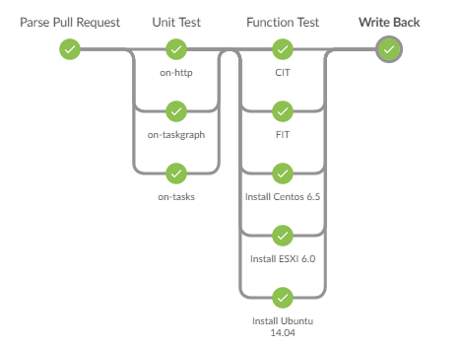
Pipeline: PR Gate
Thanks to @Andre & @Tian
Parallel
Parallel
An example of on-tasks pr
PR dependency
Example
Comment back to PR
Generate Manifest
Example
Notes:
This is a typical pr-gate pipeline.
When triggered, a pr parser will parse the pr info and generate manifest.
Two definitions:
PR Dependency: See this example, you can write …. in pr desc to show the dependency relation between prs.
Manifest: is the parser output, see example, it will contains all prs and other latest master commits, and based on the dependency relations, the trigger pr will be signed as under-test,
Any inter-dependent pr of under-test pr will be set under-test too. This is for result write back.
We have detailed guideline for how to use pr gate.

Slide 22
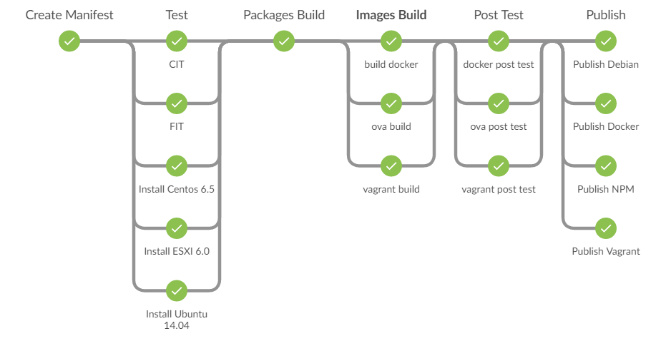
Pipeline: Nightly Build
.deb Build
Lock down test base
OVA & vagrant are
Installed from deb
will add FIT soon
RAC-3978
Source base Tests

Slide 23
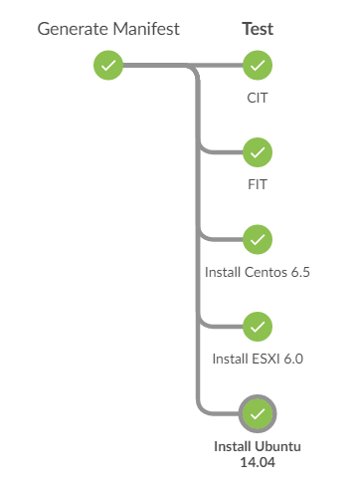
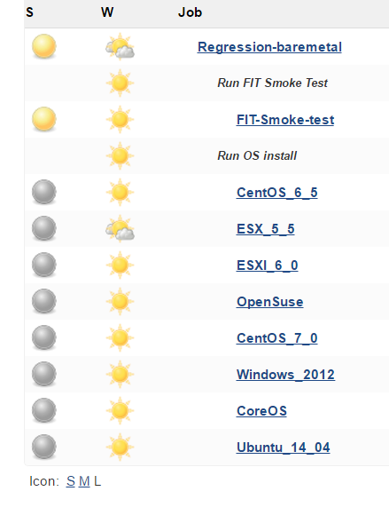
Pipeline: Continuous Func Test & Continuous-OS-Install

Slide 24
Release Process

Slide 25
Release Process
Sprint ends
Opened P1 JIRA RAC
Func Test
Build Deb
Build OVA
OVA Post Test
Push git tag
N
Build Vagrant
Vagrant Post Test
CIT
Publish all images
Create temp manifest
FIT
Build Docker
Docker Post Test
Bump Version
Install ESXi
Create 2.7.0 manifest
Install CentOS
Put manifest to Bintray
Install Ubuntu
Failure
Notes:
Before we move to Sprint Regression & Sprint Release pipeline, we should revisit the current release process first.

Slide 26
Release Process…
Sprint ends
Push git tag
Opened P1 JIRA RAC
N
Create temp manifest
Test & Build
Publish all images
Release Notes
Bump Version
Y
Any Failure
If freezed
N
Create 2.7.0 manifest
Y
Put manifest to Bintray
Y
Freeze Lift
Failure
Y
N
Wait next sprint
If Skip Release
random issue(can retry)?
N
Merge freeze
Hot fix
Y
Still use 2.7.0 version, uncheck “version bump” parameter
Bump patch version:New version 2.7.1

Slide 27
Others

Slide 28
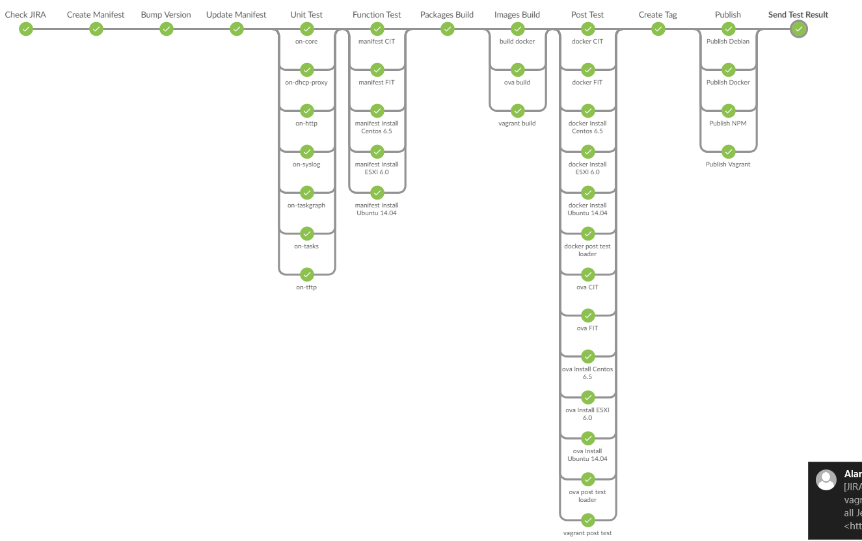
Pipeline: Sprint Release
Sprint-Release

Slide 29
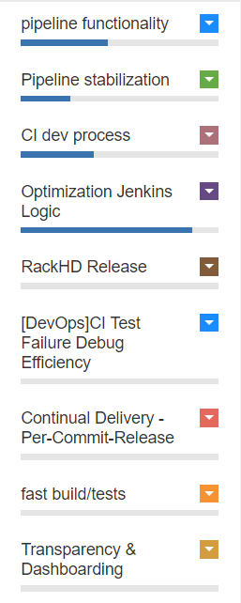
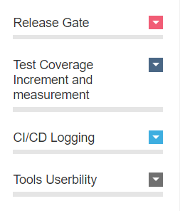
CI/CD Roadmap
CI/CD Roadmap is managed as epics in bri view
Stories categorized in diff areas [Thanks all to contribute good ideas!]
Example:
Run FIT against build OVA/docker..[RAC-3978]
Add on-imagebuilder/on-skupack PR Gate[RAC-4536][[RAC-4033]
PR Gate for CI/CD changes [RAC-4571]
Bare OS in test instead of vagrant [RAC-4456]
Make pipeline more informative [RAC-4574]
Per-Commit Release
Easy Dashboard (on TV?)
Manage Jenkins build history/logs by ELK [RAC-4338]
by 2017/3/24

Slide 30
CI Dev : Process & Co-work
Dev Process
Workflow:
Roadmap → Design review → Sandbox testing → PR → Production online on AM → manual run as integration test → maintenance
PR
Best practice : background explanation , show test result & test case ……
PR Gate of CI works ^{[RAC-4456]}
Global Co-work (proposal)
Sync-up Interlock (regular forum ?)
Roadmap discussion
EPIC/Story dispatch
Transparence since design review phase
Co-Maintain for issues (24H!)
Confluence(?) to record significant Jenkins change (not all Jenkins admin change are trackable )

Slide 31
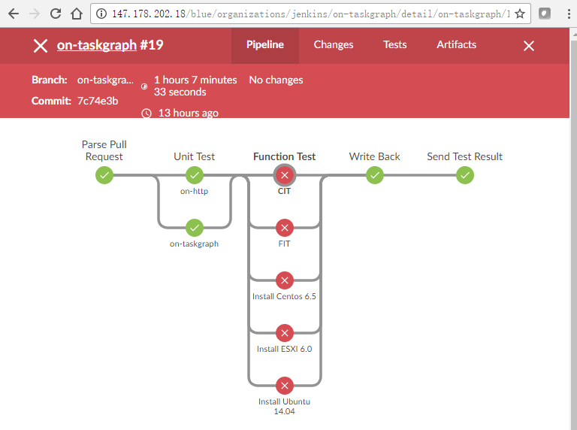
Jenkins Mirror
As an open source project , “Transparence” to community is golden rule . ---- “Fair”.
When an external PR failed, although there will be comment in GitHub, but sometimes not enough.
URL link to PR test page in Jenkins Mirror : pipeline state, test report , log details…
It’s Read-Only .( can’t trigger any test on mirror)
Sensitive info have been carefully taken care. (e.x. IP hidden, ENV disabled )
Notes:
- The Transparence:
Just like some PSO security docs, although there will be few people will read it (I guess), but it’s still necessary.
Is xunit report(XML) enough ?
there’s some cases xunit-report not generated which failed in previous steps. (like http://10.240.19.21/blue/organizations/jenkins/MasterCI/detail/MasterCI/59/pipeline)
and Jenkins will provide the pipeline view , which clearly tell which step(FIT/OS-Install) failed.
other than xunit-report, sometimes, the RackHD’s vagrant log or vNode’s SOL log are also helpful.

Slide 32
Jenkins Pipeline Matrix (update 20170601)
Pipeline job | Trigger | RackHD code which Tests are based | Test suites | Output | Test Environment
PR Quality Gate | Jenkins GitHub PR Plug-in | PR content in Manifest | Smoke-Test(CIT+FIT) + 3 OS-Install | PR status + PR comments | Running on virtual hardware
Master CI (Nightly Build) | Timer – Daily (EST 12:00AM) | Commit by that day in Manifest | Smoke-Test + 3 OS-Install + image-post-test | deb/npm/vagrant/docker in cloud. ova in Jenkins. manifest in Bintray Slack/email notification when failure | Running on virtual hardware Near Term Improvement to migrate to running on all physical hardware
Sprint Tag (Sprint Regression) | abandoned
Sprint Release | Timer trigger (Every sprint ends) | A Manifest URL | Same as Nightly Build | bump version in package.json & deb/changelog add x.y.0 tag Build/publish images manifest in Bintray | Running on virtual hardware
Continuous-Function-Test | every hour | Master tip | Smoke-Test |  | Running on virtual hardware
Continous-Unit | every 20 min | Master tip | Unit-Test
Regression-baremetal | Every 12 hours | Master tip | FIT+OS-Install |  | Running on Physical Machines
Notes:
This page will not be talked too much, but just a quick overview

Slide 33
Pipeline Tips

Slide 34
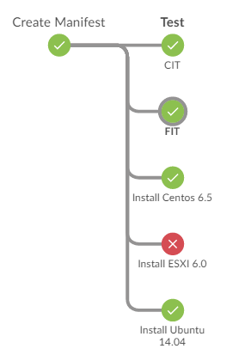
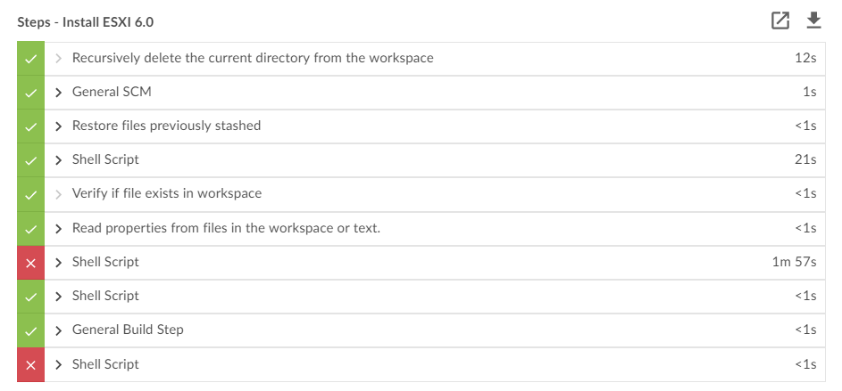
Pipeline Tips
Go back to non-pipeline view
Click a step in pipeline, it will show the sub-steps and time used.
If clicking a failing step, it will directly jump to failure location.
The sub-steps are equal to previous console logs.

Slide 35
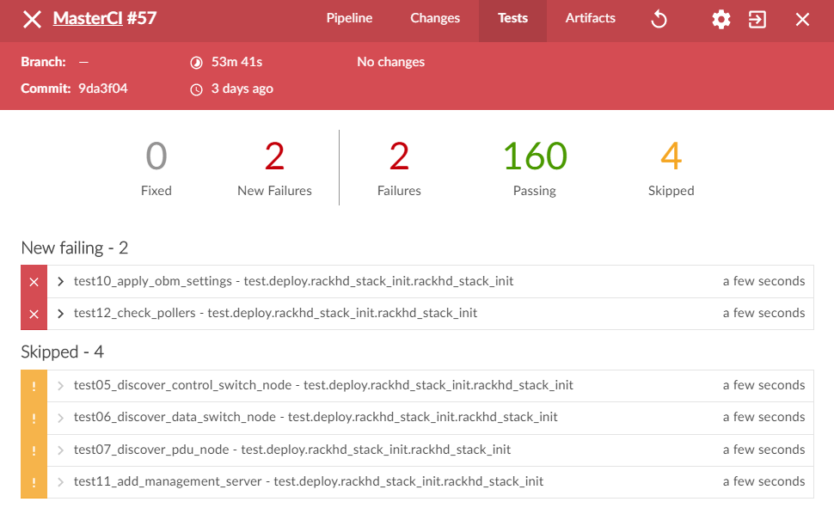
Pipeline Tips…
Go to “Tests” tab. Showing the failure test cases and unfolder to see details

Slide 36
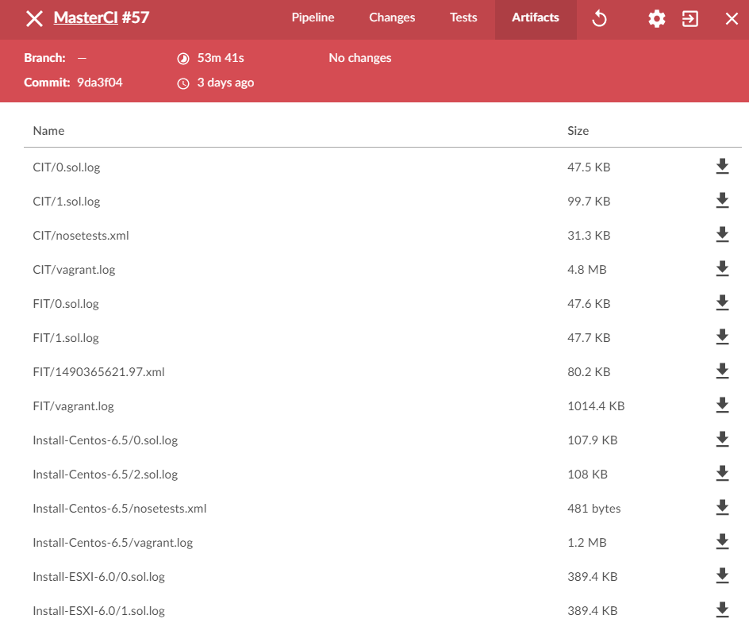
Pipeline Tips…
Go to “Artifacts” tab for build images or various logs.

Slide 37
Backup – More Tips

Slide 38
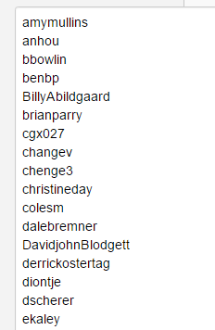
GHPRB & PR Gate language
It’s Jenkins’s GitHub PR Builder Plug in
Admin list
ok to test*
add to whitelist
White list
PR can trigger Jenkins test
ok to test: if CC don’t want to add an external fork to a permanent whitelist, can use “ok to test” to accept the current PR to go to Jenkins test
add to whitelist: NOTE: only take effect for a repo. Because each repo has a Jenkins watch job. They had separated GHPRB white list table.
This plug-in is bugful and had caused lots of pain …… T_T

Slide 39
Challenge from on-imagebuilder
Previously, TravisCI builds static files to Bintray without version control, and without CIT test.
Now, it’s in deb package , which is version controlled and validated .
Local latest cache, For PR Gate, to avoid download from bintray every time ( it may cost money ! )
The build will take 1 hour. To save time, if no new commit, Jenkins will retrieve old image instead of rebuild.
How to download static files of correct version ? (e.x. npm install rackhd=1.3.0) * RAC-4347)
NOTE: With new Rachel-OS introduced, lots of thing may change

Slide 40
rackhd.deb
What for ?
Easy single command installation : ```apt install rackhd```
Auto install on-xxxx.deb & on-imagebuilder.deb
Auto adding config file
Config network if user agree
Managed by ```service start/stop rackhd```

Slide 41
Jenkins Tips
Config privilege only opened to RackHD.CI & CC
Parameterized Build
Build Trend
“View”

Slide 42
Engineering Builds
Docker
Per-commit build by dockerhub, tag as “devel”
On-imagebuilder
Per-commit build by TravisCI, Static file are stored in bintray
Vagrant
Monorail team use vagrant as v-Stack a lot. So we build vagrant-dev box on demand.

