Slide 1
Feature Management
Utilizing Atlassian’s Jira Portfolio
Tom Sullivan

Slide 2
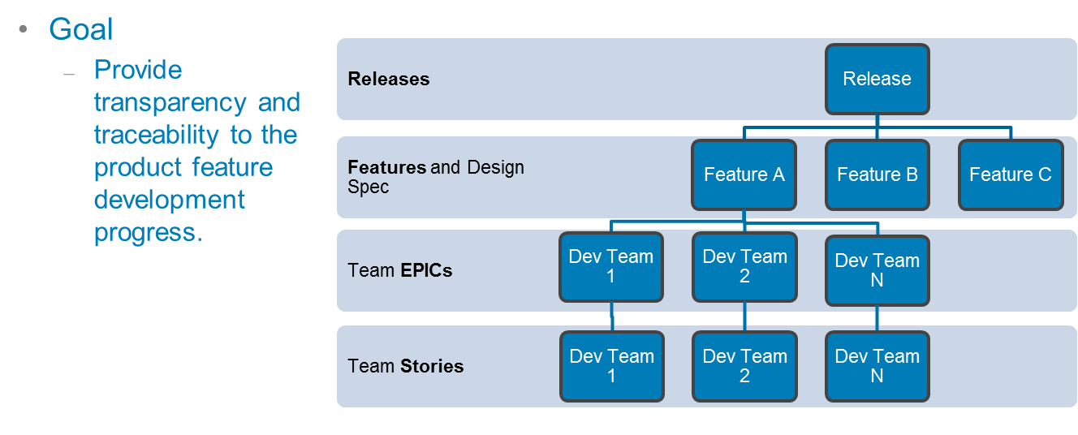
Hierarchy of Feature Management

Slide 3
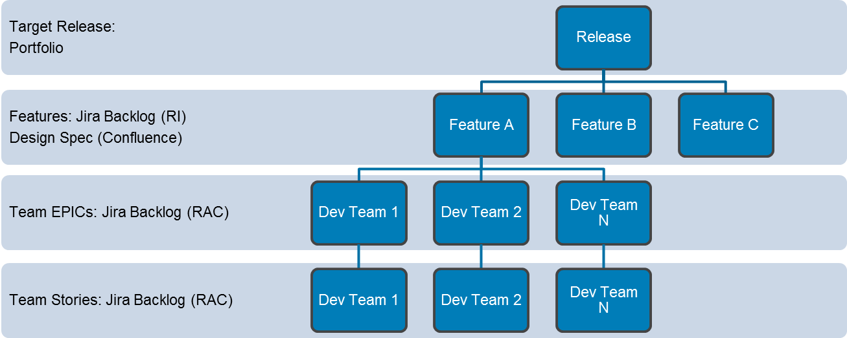
Feature Management: Portfolio / Confluence

Slide 4
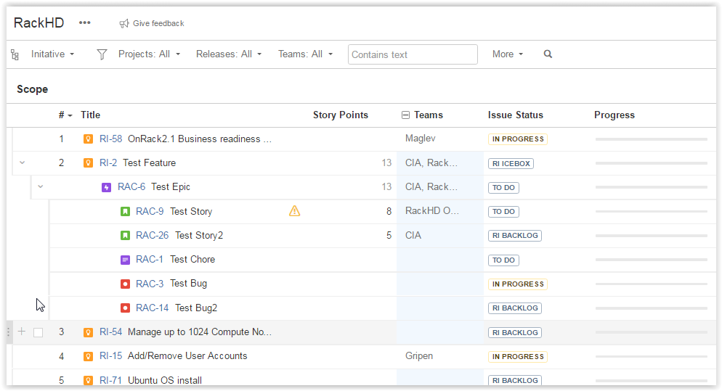
SW Feature management with Portfolio
View of Jira Portfolio for RackHD
Jira portfolio allows a parent relationship to set up another level of hierarchy “initiatives” on top of EPICs.
The hierarchy
Initiative (RI backlog): Features
Epics (RAC Backlog)
Stories, chores, bugs (RAC Backlog)

Slide 5
SW Feature management with Portfolio
RackHD Initiatives (RI backlog):
Initiatives
RackHD initiatives (RI) are linked to the epics by a parent link
Initiatives are kept in a separate backlog so that a multiple to multiple relationship between features and products (This is recommended and may be useful in the future)
RackHD (RAC Backlog)
Bugs, Epics, Stories, and Chores
The RackHD epics are linked to the initiative by way of a parent link.
Stories are created from Epics.
Chores and bugs are also kept in this backlog
It is assumed that team ownership will be done at the Epic layer
Teams can be assigned to the Epics and each team will have its own Jira board

Slide 6
SW Feature management with Portfolio
RI Feature Plan
Portfolio RackHD
RackHD Initiatives Boards (RI)
RI Stack Ranked board (Kanban)
RI board_Active Feature Status (Kanban)
Planned RackHD Dev Boards
RAC board_All Issues (Kanban)
RAC board_Bugs (Kanban)
RAC board_Team Corsair (Scrum)
RAC board_Team Maglev (Scrum)
RAC board_Team Gripen (Scrum)
RAC board_Team Monorail (Scrum)
RAC board_Team Styker (Scrum)
RAC board_Team Mustang (Scrum)

Slide 7
SW Feature management with Portfolio
Two backlogs can use a different workflows and each issue type can have a different workflow.
Keep as simple as possible and consistent within reason across the backlogs.
Be consistent with the two workflows
Use a simplified workflow that is managed by Jira.
https://confluence.atlassian.com/agile/jira-agile-user-s-guide/configuring-a-board/configuring-columns/using-jira-agile-simplified-workflow

Slide 8
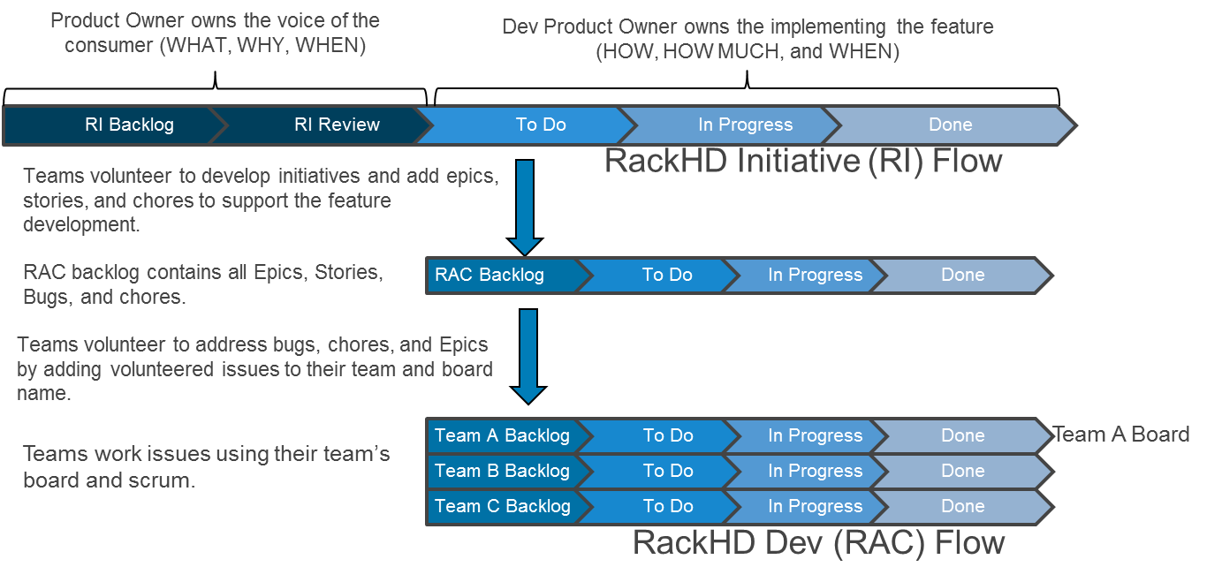
RI and RaC Flows

Slide 9
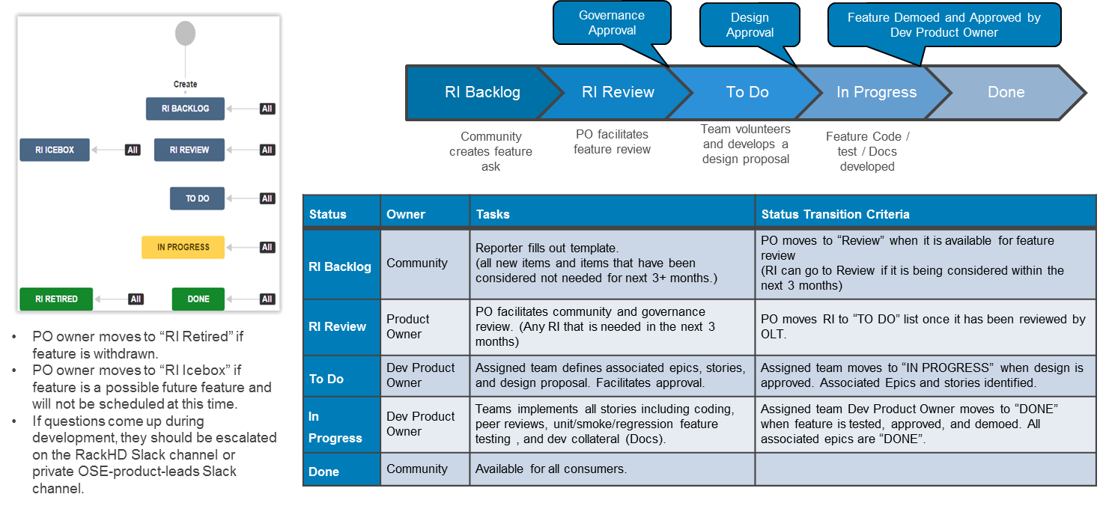
RackHD Initiative (RI) Flow (Kanban)

Slide 10
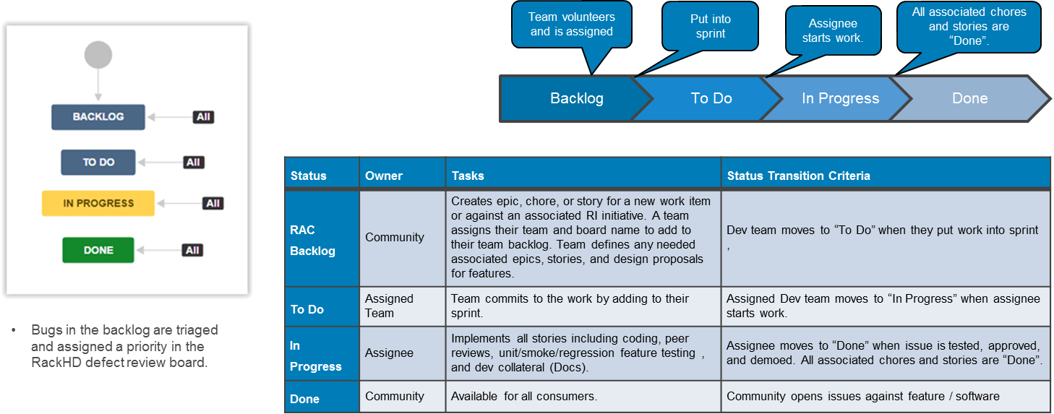
RackHD Dev (RAC) Flow SCRUM

