Slide 1
ORFS# / Subject
Presenter | Tian,Peng
Consumer (BU, PO, Test, Dev, All stakeholders, …) | All
What will be presented | Convert Master CI into pipeline Apply manifest mechanism to PR Gate Convert PR Gate into pipeline
Why (Partial feature, completed ORFS, ODR, …) | Feature: Enable Jenkins2.0 feature: pipeline Reduce the complexity of PR Gate
Next Steps | Convert Continuous Test jobs to pipeline Optimize pipeline: reduce time

Slide 2
Why pipeline
-Jenkins logic “as code” & source control
-Better Visualization
-Reduce the complexity of job hierarchy

Slide 3
Jenkins jobs
1. MASTER CI
2. PR GATE

Slide 4
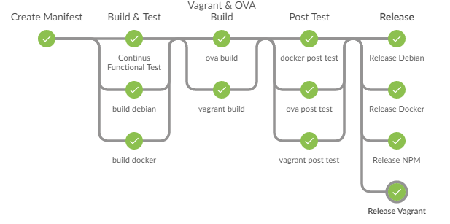
MASTER CI

Slide 5
PR GATE
Design
FAILED
parallel
Unit Test
Function Test
Manifest file
Manifest file
Parse
Pull Request
On-core
CIT
Write back
On-tasks
FIT
On-http
Install Centos 6.5
……
Install EXSI 6.0
Install Ubuntu 14.04
Notes:
Manifest

Slide 6
How Manifest helps PR Gate
* Decouple “test” and “trigger” (PR monitor & PR analytic)
* Benefit:
- Track what code was tested
- Capable to be re-tested anytime
- Resolve dependent PR easily
Guideline/Best practice of using RackHD PR Gate(Jenkins Test)

Slide 7
How Manifest helps PR Gate
Example Manifest(single PR)
{
"branch": "",
"commit-id": "38b20e4687f0ea97339943adea13783bd23d7868",
"repository": "https://github.com/RackHD/on-core.git"
},
{
"branch": "",
"commit-id": "origin/pr/406/merge",
"repository": "https://github.com/RackHD/on-tasks.git",
"under-test": true
},
…
How Manifest decouple the PR Gate logic
when “under-test”= true, then result will be written back to PR
Notes:
Manifest

Slide 8
How Manifest helps PR Gate
Example Manifest(PR on-tasks #407 depends on-taskgragh #300)
{
"branch": "",
"commit-id": "38b20e4687f0ea97339943adea13783bd23d7868",
"repository": "https://github.com/RackHD/on-core.git"
},
{
"branch": "",
"commit-id": "origin/pr/407/merge",
"repository": "https://github.com/RackHD/on-tasks.git",
"under-test": true
},
{
"branch": "",
"commit-id": " origin/pr/300/merge ",
"repository": "https://github.com/RackHD/on-taskgraph.git"
},
…
How Manifest decouple the PR Gate logic
when “under-test”= true, then result will be written back to PR
Notes:
Manifest

Slide 9
How Manifest helps PR Gate
Example Manifest
(inter dependency PR: on-tasks #408; on-taskgragh #301)
{
"branch": "",
"commit-id": "38b20e4687f0ea97339943adea13783bd23d7868",
"repository": "https://github.com/RackHD/on-core.git"
},
{
"branch": "",
"commit-id": "origin/pr/408/merge",
"repository": "https://github.com/RackHD/on-tasks.git",
"under-test": true
},
{
"branch": "",
"commit-id": " origin/pr/301/merge ",
"repository": "https://github.com/RackHD/on-taskgraph.git",
"under-test": true
},
…
How Manifest decouple the PR Gate logic
when “under-test”= true, then result will be written back to PR
Notes:
Manifest

Slide 10
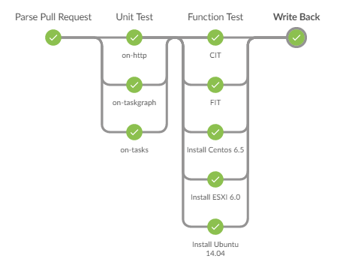
PR GATE
An example of dependent PR(on-http depends on on-tasks):
 | Duration
pipeline | 39min^{[1]}
Original PR Gate | 55min
[1] the 16 mins time saving should thanks to parallelize of unit-tests & manifest simplifies the job hierarchy

Slide 11
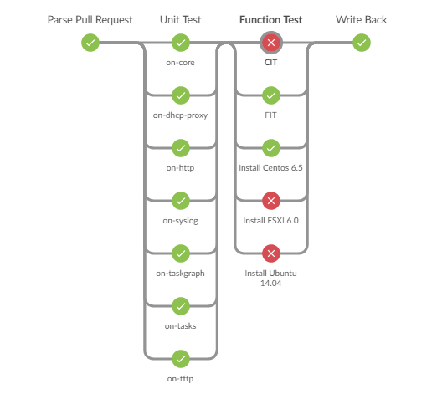
PR GATE
An example of PR(on-core):
 | Duration
pipeline | 39min
Original PR Gate | 49min
the time saving should thanks to parallelize of unit-tests & manifest simplifies the job hierarchy

Slide 12
Implementation
On-xxx Jenkins Job^{[1]}
(Ghprd plugin)
trigger
Manifest file
Manifest file
Parse Pull Request
Unit-Tests
CIT/FIT/OS-Install
Write back
PR #91
pr_parser.sh to analysis the PR , check if it’s single PR or dependent PR.
Then it will output a manifest file( as example in Page 7~9)
PR #88
In unit_test.groovy,
reprove.py will clone/checkout every repo , according to manifest (output from pr parser stage)
Leverage pipeline “parallel test_branches” , to safe time.
Analysis the results
PR #88
In function_test.groovy
1. “function_test.sh” is equivalent to previous “test.sh”: use reprove.py to checkout code according to manifest
2. “parse_test_results.py” to analysis the xunit-report.
PR #88
In write_back_github.groovy
1. Collect the previous results, write the result back to PR (as PR comments ), only for those PR marked as “under-test": true in manifest.
[1] GHPRD plugin hasn’t been enabled pipeline feature. So we have to use a “shell” as a trigger. It’s not visible to users.

Slide 13
Next step
1. Add more logs to job archive, such as vagrant log, sol log…
2. Pilot run of PR Gate pipeline for 1~2 weeks ( on dev Jenkins )
If stable (no new issues than original PR Gate), then switch to production before the end of next sprint.
3. Convert other Jenkins jobs into pipeline
4. Optimize pipeline to reduce time:
- In test.sh: run “npm install” and “vnode delete&create”, “vagrant cleanup” in parallel

